Slide 1
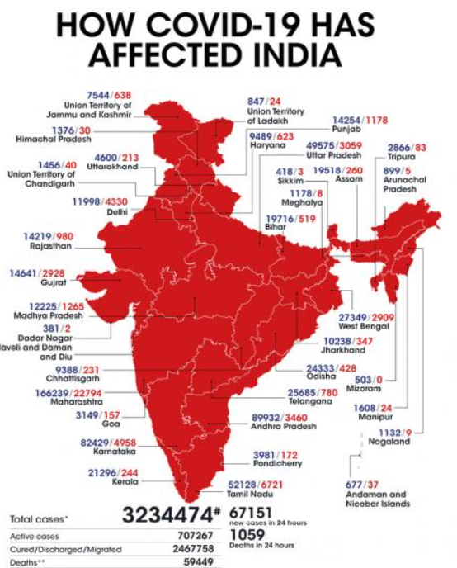
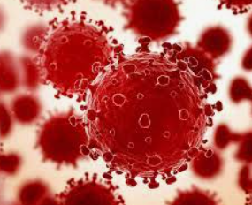
India fights Corona Covid-19
Coronavirus disease (COVID-19) is an infectious disease caused by the SARS-CoV-2 virus. Government of India is taking all necessary steps to ensure that we are prepared well to face the challenge and threat posed by the growing pandemic of COVID-19 the Corona Virus. Purpose of this project to represent the state wise data of num of cases of corona, deaths, cured , vaccinated & how Corona has impacted the life .And the majors taken to get people vaccinated .

Slide 2
Some possible questions and points to explore?
Top/bottom 10 states with highest number of Confirmed cases
Top/bottom 10 states with highest number of Cured cases
Top/bottom 10 states with highest number of Deaths
Top/bottom 10 states with highest of Death percentage
Top/bottom 10 states with highest number of Total Samples
Top/bottom 10 states with highest number of Negative cases
Top/bottom 10 states with highest number of Positive cases
Male and Female Vaccinated ratio for Covid19
Covaxin and Covishield Vaccination
Doses administered vs People Vaccinated

Slide 3
Top 10 States with highest number of Confirmed cases | Sum of Confirmed
Andhra Pradesh | 374631235
Chhattisgarh | 154749830
Delhi | 274298085
Karnataka | 462620921
Kerala | 427313974
Maharashtra | 1070657336
Rajasthan | 153785608
Tamil Nadu | 408786439
Uttar Pradesh | 297247727
West Bengal | 249317376
Grand Total | 3873408531
10 Bottom number of Confirmed cases | Sum of Confirmed
Andaman and Nicobar Islands | 1870612
Arunachal Pradesh | 6730183
Cases being reassigned to states | 345565
Dadra and Nagar Haveli and Daman and Diu | 1863487
Ladakh | 3870882
Lakshadweep | 823634
Mizoram | 2594668
Nagaland | 4785970
Sikkim | 2938742
Unassigned | 161
Grand Total | 25823904

Slide 8
ANALYSIS OF DATA PRESENTS STATS AS BELOW
Maharashtra has & had the highest count of Confirmed cases & Lakshadweep with lowest confirmed cases .
Maharashtra has & had the highest count of cured & positive cases & Lakshadweep with lowest cured & positive cases confirmed cases .
Maharashtra has the highest death cases & Dadra and Nagar Haveli and Daman and Diu with lowest Death cases .
Uttar Pradesh has the highest total sample & Dadra and Nagar Haveli and Daman and Diu with the lowest
Andhra Pradesh has the highest Nagative cases & Mizoram,Maniour with Lowest
Ratio of Male vs Female vaccinated is 11/7
Ratio of Covaxin and Covishield Vaccination 1/8
Ratio of Doses administered vs People Vaccinated 12/9
However India has successfully vaccinated the 100% population at least with the 1st dose

